Slide 1

BI- and Big Data Design Workshop
Unsupervized Clustering of Recipes and Visualization with Tableau
Nicolas Henzel
Niels Simmet
Alexandra Speer
Lukas Zaiser

Slide 2

Agenda
Objective
Technical Setup
Preprocessing
Exploratory Data Analysis
Model Results
Final thoughts and Lessons learned

Slide 3
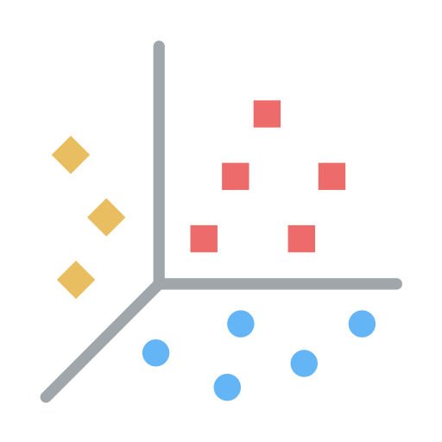
Objective
Analyze a provided file of 1000 recipes.
Preprocess the unstructured data and perform exploratory data analysis to gain insights into the dataset.
Build clusters using different algorithms, features and preprocessing steps.
Evaluate the outcomes of the clustering algorithms and draw meaningful conclusions.

Slide 4





Technical Set Up
Virtual Python Environment
For exploration, preprocessing, modell training, etc. with fixed package versions to ensure compatibility
Local Mlflow Server
Tracks, visualizes, scores and compares trained models, params, artifacts, tags, etc.
GCP Bucket
Stores trained models and their artifacts
Tableau Desktop
For visualizations
GitHub Repository
For collaboration on py-scripts, notebooks, README, etc. and data storage, mlflow.db

Slide 5






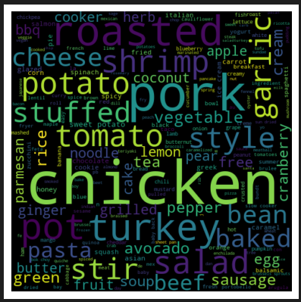


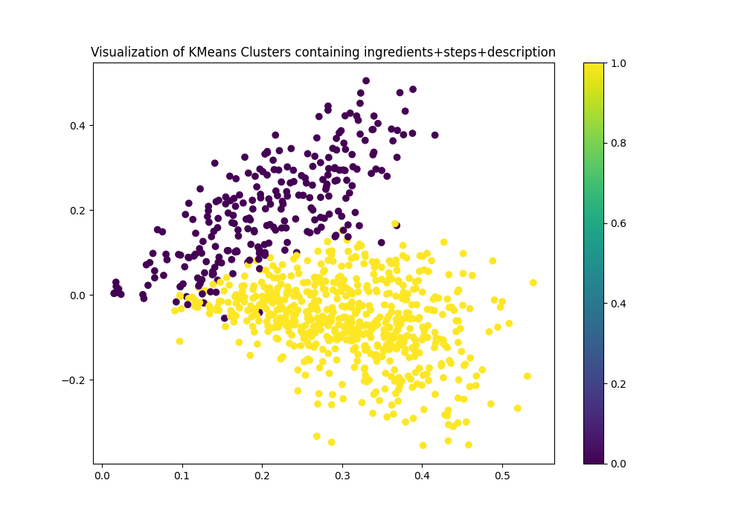

Pipeline Structure
df_recipes.pkl
df_recipes_no_stopwords.pkl
Recipes.csv
run_preprocessing.py
run_modelling.py
preprocessing_functions.py
modelling
_functions.py

Slide 6
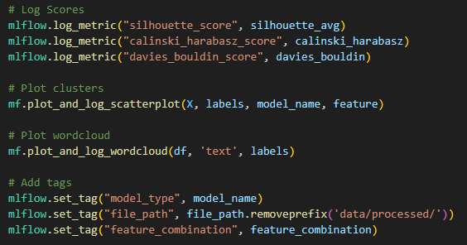
Mlflow logging
Metrics
Silhouette Score
Calinski Harabasz Score
Davies Bouldin Score
Artifacts
Scatterplot (logging in function)
Wordcloud (logging in function)
Model (Autologging)
Additional Tags
Model type
Used preprocessed file
Feature combination

Slide 7
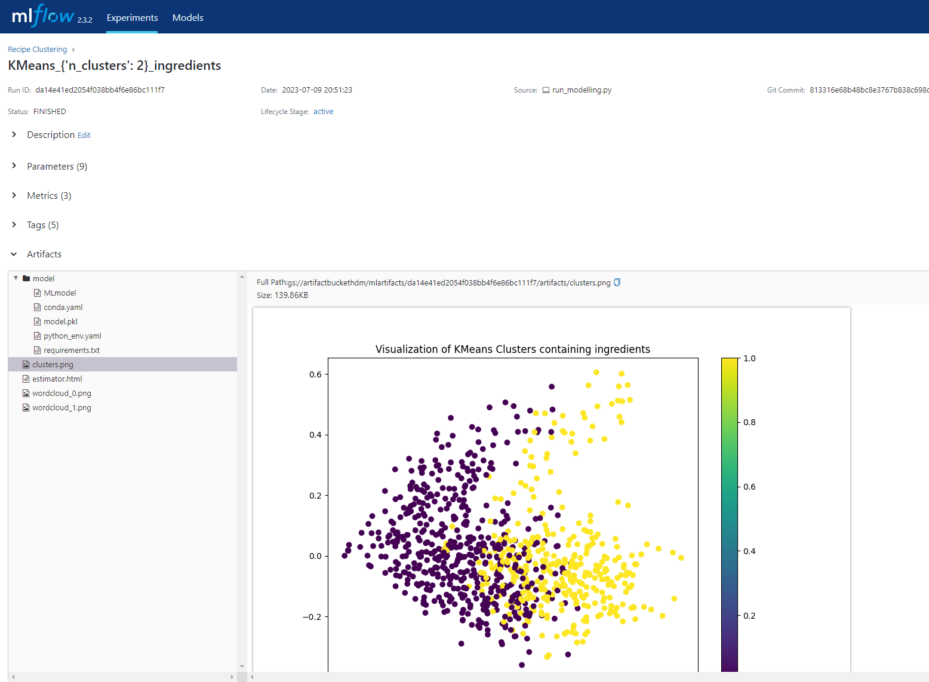
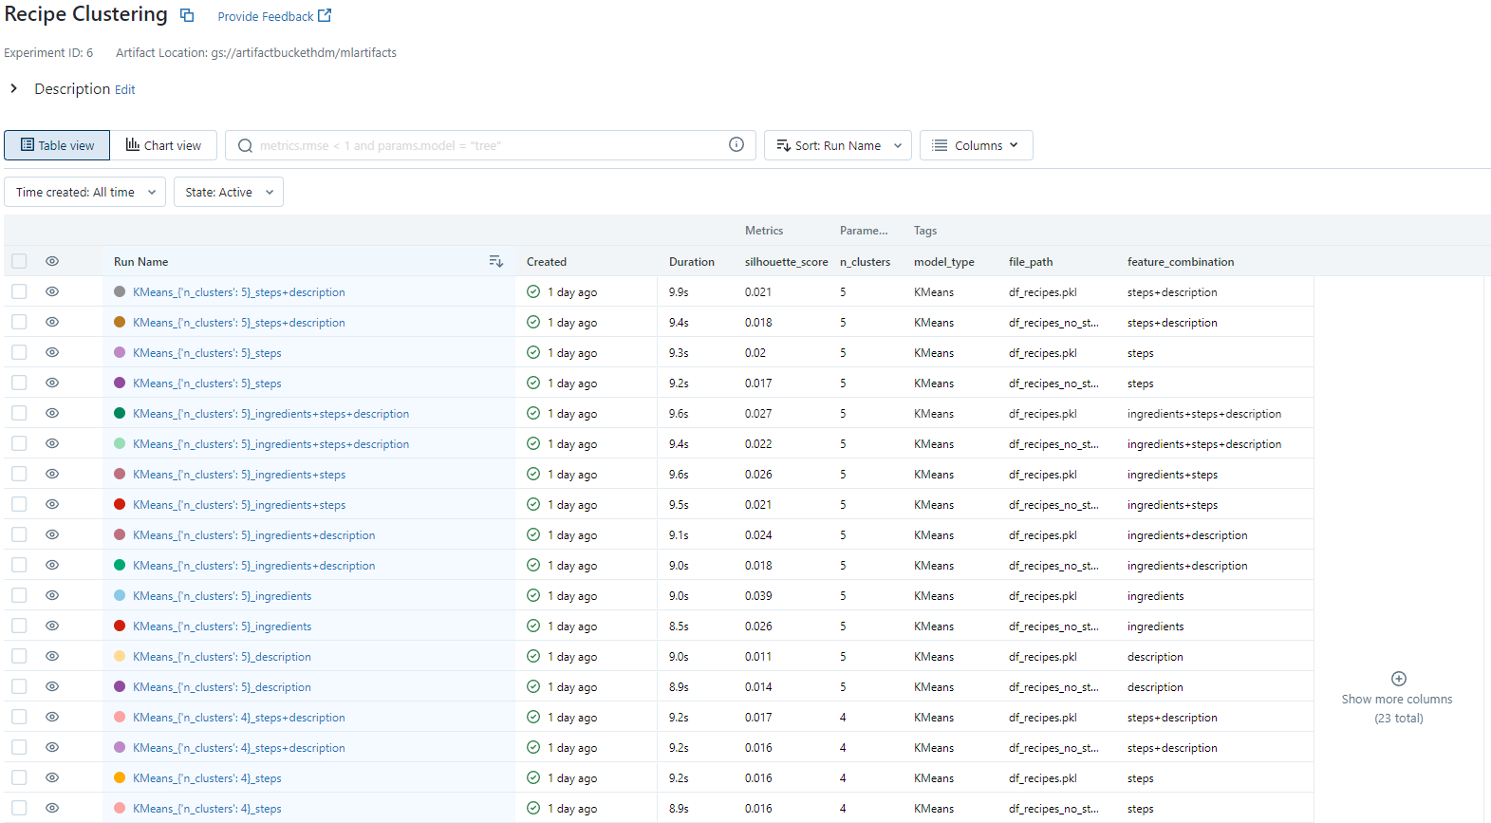
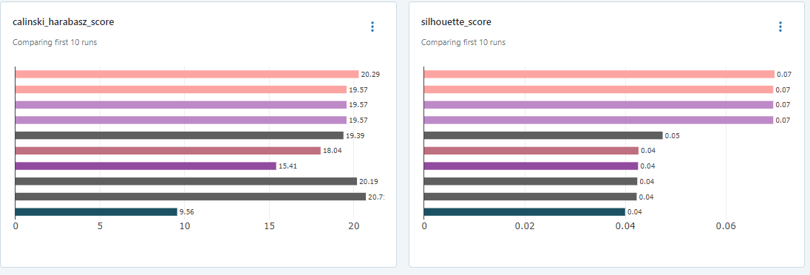
mlflow

Slide 8



Preprocessing pipeline
Language detection: Filter all non-english recipes
We used the package langdetect
Remove all punctuations
Tokenize text into a list of words using NLTK’s word_tokenize
In addition to 1), filter only English words using nltk.corpus.words
After having only English words left, we applied these additional steps
Define POS tag with nltk.pos_tag
Words must not be capitalized for that!
Lemmatize words with WordNetLemmatizer
Drop default english stopwords
Capitalize all words
Later: Drop additional domain stopwords
Notes:
An der Vorlesung orientiert
Hard(er) to get it right than expected
Langdetect ist von google (language-detection library)
Part of speech tag

Slide 9
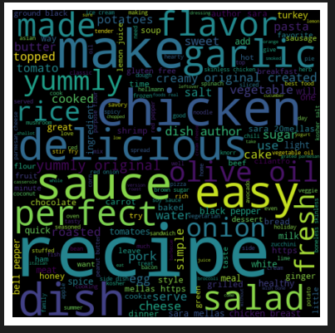
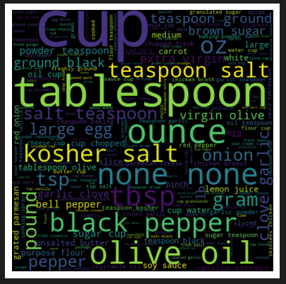
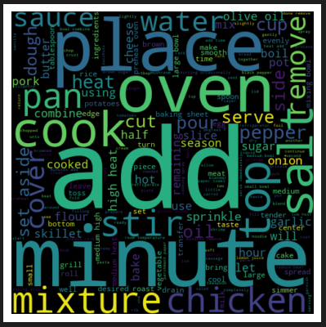
Word Clouds of recipes after NLTK preprocessing (Domain stopwords still included)
Name
Description
Ingredients
Steps
We see a lot of chicken recipes. On first view we could therefore expect chicken to be a top ingredient, but we already see that there are a lot of cooking weights and measures in the ingredients. We do see chicken to appear often in the description column, but also words like “easy”, “perfect” and “yummly” to describe the type of recipe.
Looking at the steps, there are obliviously a lot of things we must “add”, or “place” in the “oven”, but we also see nouns like “chicken” and “salt” in there.

Slide 10
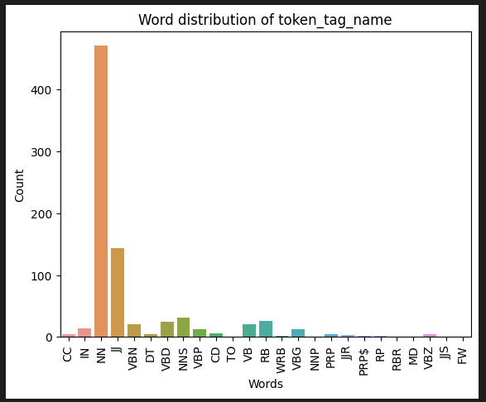
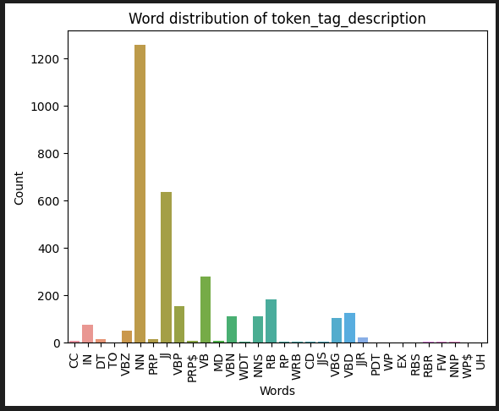
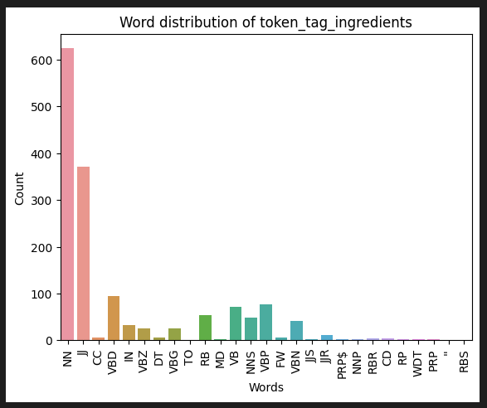
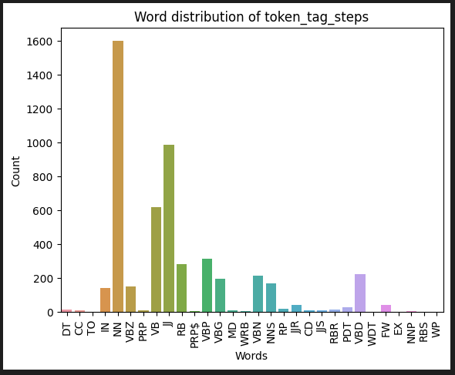
Visualization of part of speech tagging
Name
Description
Ingredients
Steps
We see the most occurrences of nouns (NN) in all columns, even in the steps column.
On the other hand, there are a lot of adjectives (JJ) in the Ingredients column.
This means we need to clean the data before being able to build reasonable clusters with it.
Therefore, we applied an additional domain stopword filter.
Notes:
https://www.ling.upenn.edu/courses/Fall_2003/ling001/penn_treebank_pos.html

Slide 11
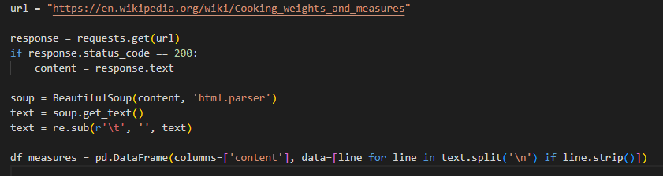
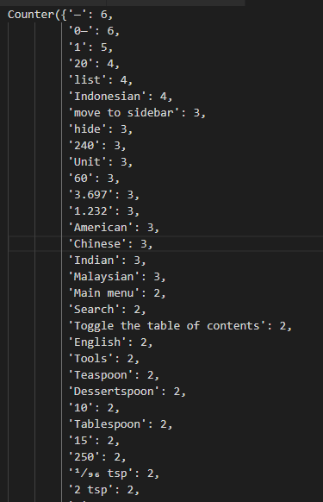
Generate stopwords from a website
Using the BeautifulSoup parser, we can get rid of HTML-Tags like <p>, <a> and so on. After that we split the text at each newline for having all the sentences of the page. The strip() gets rid of all empty lines.
In this example we use cooking weights and measures to filter out words like: CUP, Teaspoon, Tablespoon
Another source could have been color, because in the later EDA we saw that basically every color is also part of the data.
The downside of this method is that it is unpredictable which stopwords it generates. It’s nice to have a starting point but as we did, it must be reviewed and refined.

Slide 12
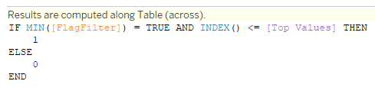
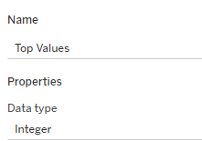
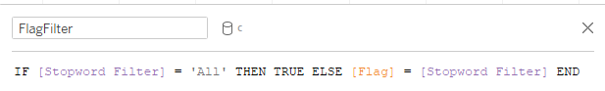
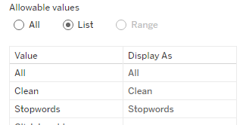
Displaying top N values with stopword filter
We solved the problem of displaying the top 10 values but considering the stopword filter.
We use an attribute that will flag the top N values as relevant that match the selected Flag (All/Clean/Stopwords).

Slide 13
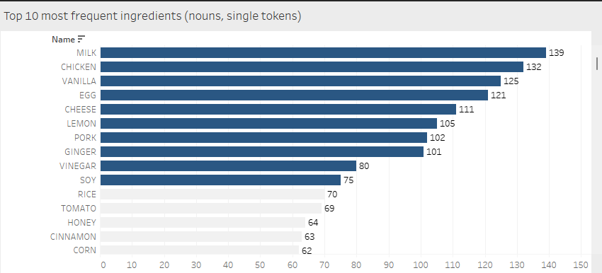
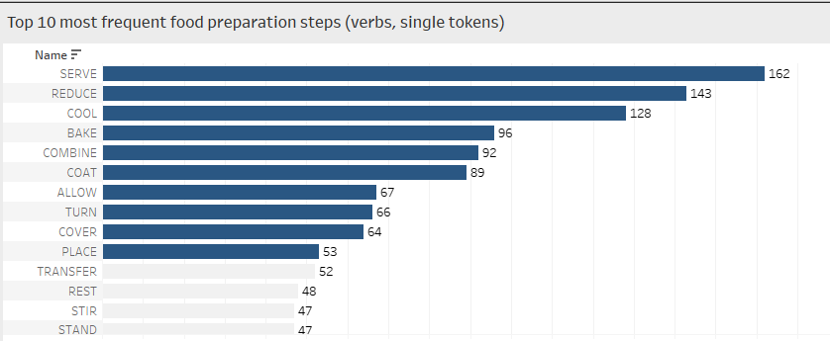
Ingredients and Steps analysis
After filtering out over 140 domain stopwords, we get this result
Ingredients
Steps
As expected, chicken is in the top ingredients list. There are also often used groceries like milk, egg, lemon and ginger.
It’s interesting that basic food like potatoes and pasta are not in the top 10 and rice also only on place 11, although our clusters will tell something different.
In contract to this, we see soy on place 10 and the high rated ginger. This can lead to the conclusion that a lot of the recipes have an Asian touch.
Milk, vanilla, egg and lemon are often used for baking so this could be another field of recipes.
In the steps we see cool very often and bake, which would match the baking theory. In a broader sense also the words coat, turn and cover could match when baking.
Serve being on first place makes sense because when finished with cooking/baking, you can serve the meal.
Reduce and combine are also often used words as in “reduce the heat” or “combine the ingredients”.
Based on the provided step words, it appears that this feature may have a relatively weak impact on distinguishing between clusters.
Notes:
Disclaimer, EDA, ohne Wissen der Cluster
Top ingredients passen zu den wordclouds
Einige Grundnahrungsmittel kommen häufig vor, andere für uns typische jedoch nicht
Häufige Lebensmittel, die im asiatischen Raum verwendet werden (Soja, Ingwer, Reis)
Ebenso Lebensmittel, die häufig beim Backend verwendet werden.

Slide 14
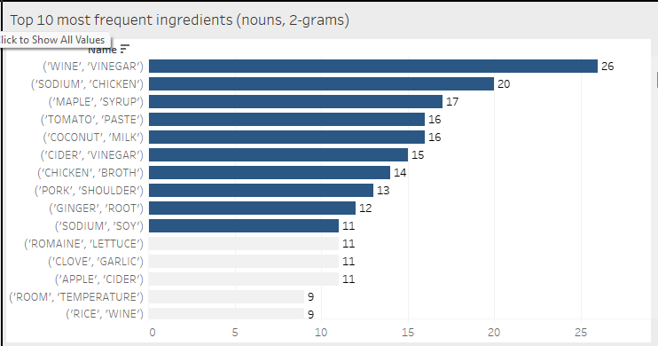
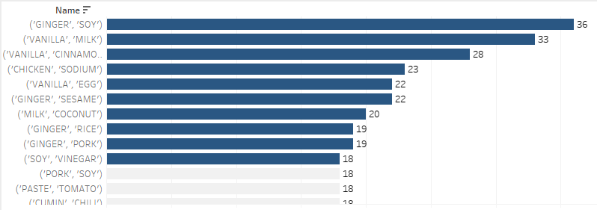
Deeper Ingredients insights
Ingredient 2-grams
Ingredient combinations
Analyzing the 2-grams we can see a lot of very common combinations.
Although there are some interesting combinations like sodium chicken, but after some analysis the ingredient is often called “low sodium chicken”.
Having “chicken broth” on the top 10, again together with “ginger root” and “coconut milk”, the assumption that we are dealing with Asian recipes gets stronger.
On ingredient combinations we see again the same patterns as before: Asian-Style cooking recipes together with baking recipes.
Notes:
- Bei den 2-Grams haben wir viele Zusammenhänge, die wir auch so erwartet hätten wie Kokusnussmilch, Ahornsirup oder auch Raumtemperatur
- Bei den Kombinationen haben wir eine Mischung aus den Ingredients und 2-grams
- Bestätigt die Theorie aus Asian & Backend

Slide 15
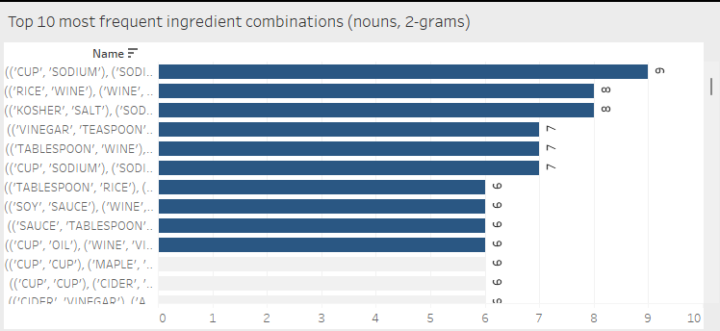
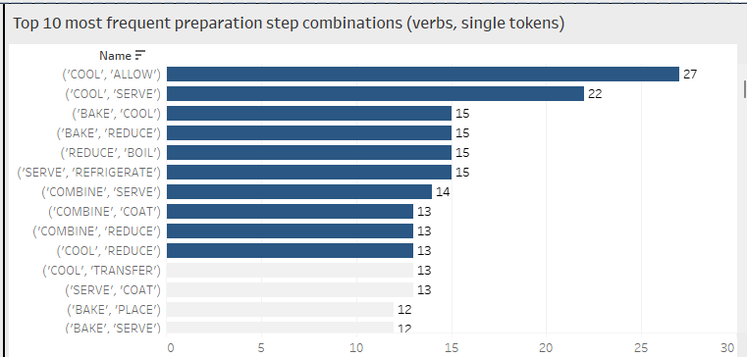
Complex ingredient and step combinations
After filtering out the stopwords, there are not many results left in these categories.
Ingredient 2-gram combinations
Preparation step combinations
We filtered the stopwords only for one 2-gram, so here we still see some stopwords like cup and tablespoon in one of them. Else we would have zero results
We see that most of the time the ingredients are combined with a measure (cup of oil, tablespoon of soy sauce, teaspoon of vinegar)
Because “cool” occurred often in the steps, we also see a lot of combinations with it.
Some useful ones may be:
Cool before serve
Bake and then let cool down
Refrigerate before serve
Combine all ingredients and then serve
Notes:
Nach stopwords nur noch wenige Wörter übrig

Slide 16
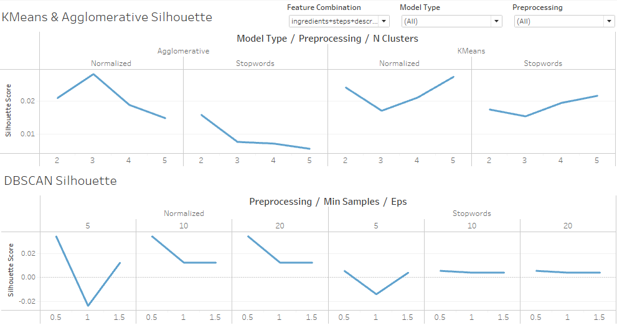
Model Results
Comparison of Algorithms
We compared the clustering Algorithms KMeans, Agglomerative (hierarchical clustering) and DBSCAN
For these three we ran different feature and hyperparameter combinations, in order to find the best configuration
The evaluation of the best configuration for each model was based on 3 Metrics to determine cluster density and separation: Silhouette Score Calinski Harabasz Score Davies Bouldin Index

Slide 17
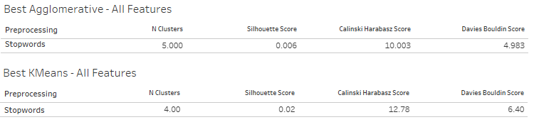
Model Results
Best Model configurations
The table above shows the best configurations and metrics for each algorithm.
The silhouette score is close to 0, which indicates that the clusters are not well defined (separation and compactness is bad). Both other metrics lead to a similar interpretation: The recipes used are very similar so that the cluster algorithm has a hard time calculating well separated and compact cluster.

Slide 18
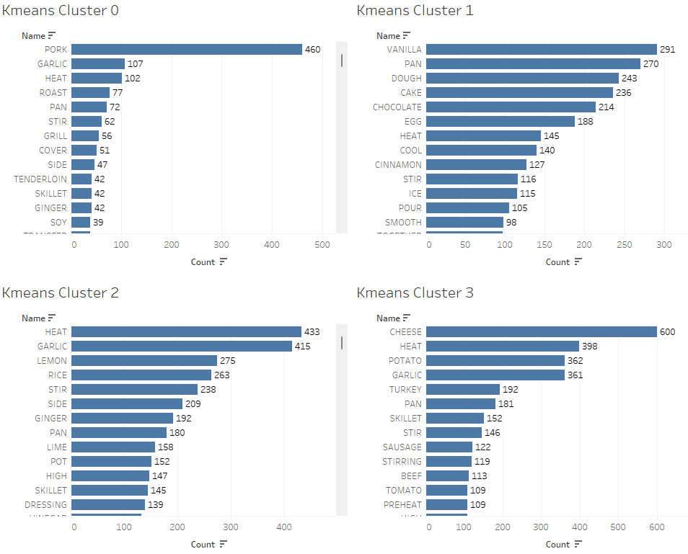
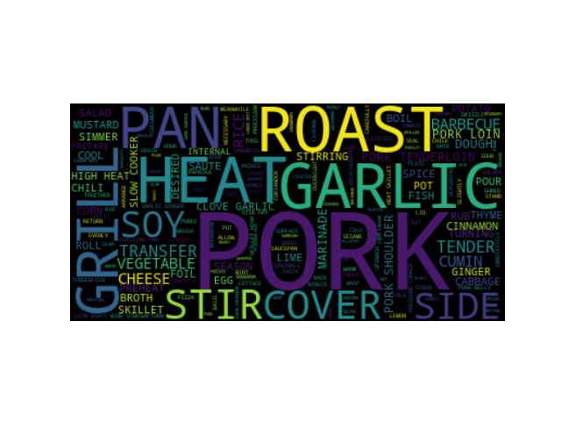
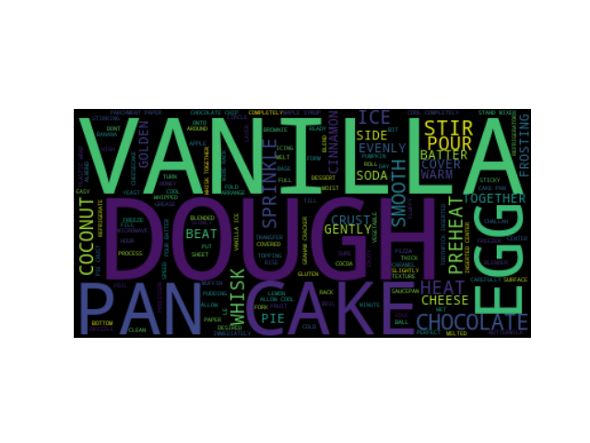
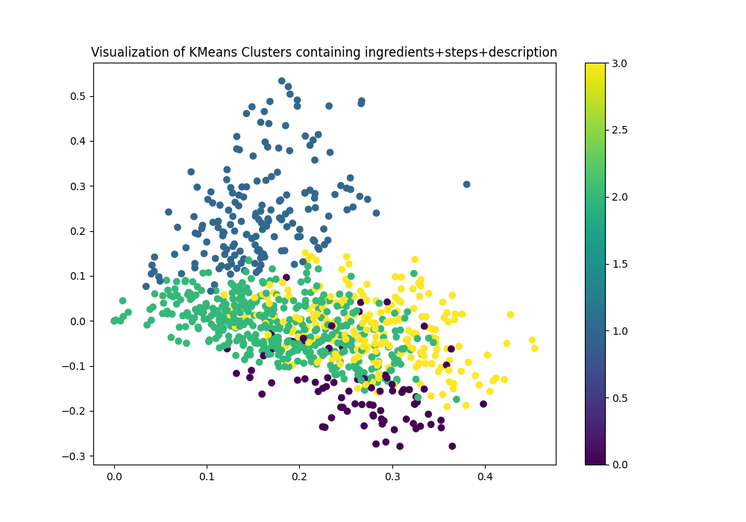
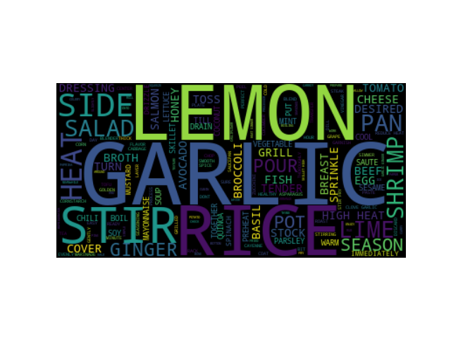
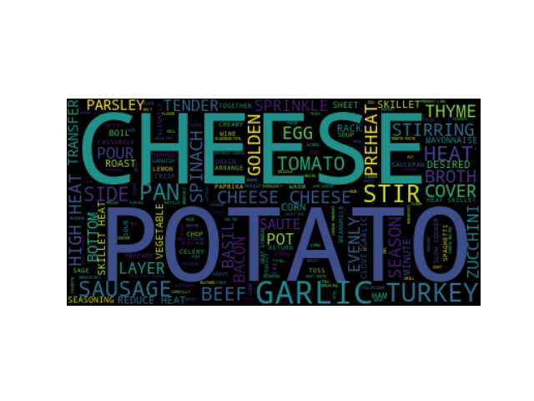
KMeans
Cluster 0 (Purple)
The cluster visualization was generated using SVD for dimensionality reduction.
Cluster 0 (purple) seems to be focused on Heated recipes with garlic and pork that are grilled, or stirred in a pan.
Cluster 1 (Blue) is about using vanilla and dough, probably making cakes with chocolate and egg, even though the word pan is very frequent.
Cluster 2 (Green) focuses on Garlic and lemony rice recipes, which are being stirred. Heat is the most prominent word here.
Cluster 3 (Yellow) covers mainly cheese recipes with potatoes. Garlic and Heat also play a big part.
The wordclouds and wordcounts show, that we have some separation within the most prominent words of the clusters. Although Heat and maybe Garlic could be additional stopwords, as they occurs in different clusters as a top word. (Which makes sense regarding cooking)
Cluster 1 (Blue)
Cluster 2 (Green)
Cluster 3 (Yellow)

Slide 19
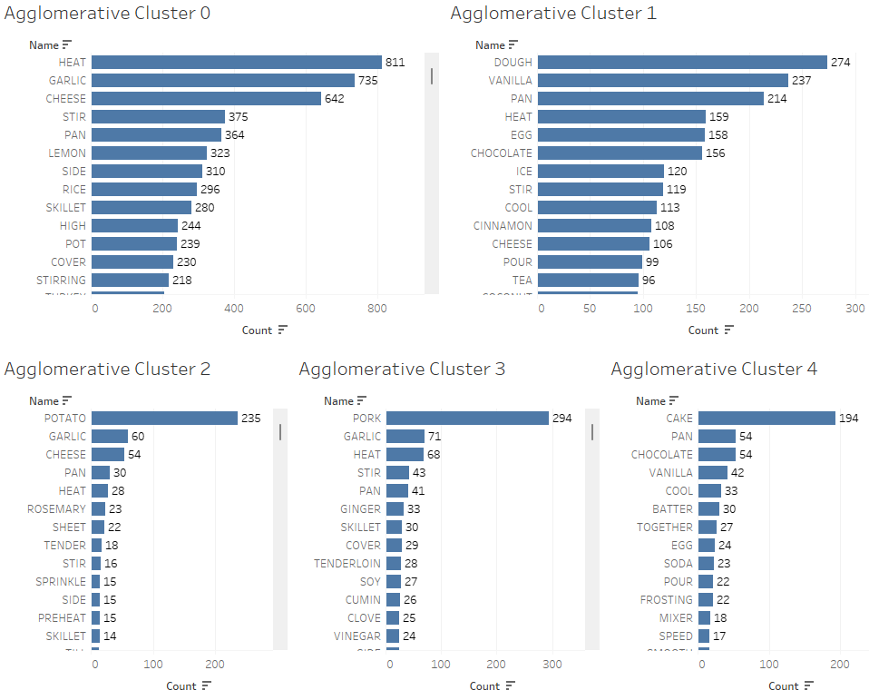
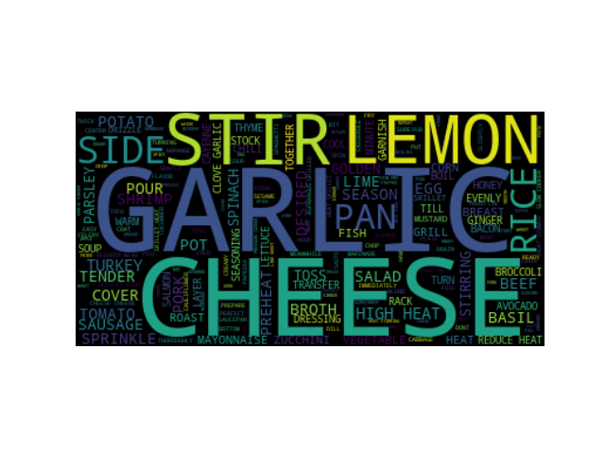
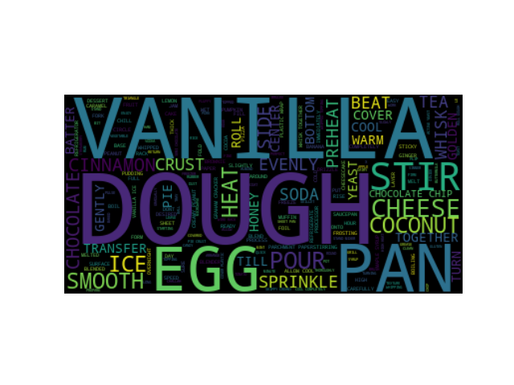
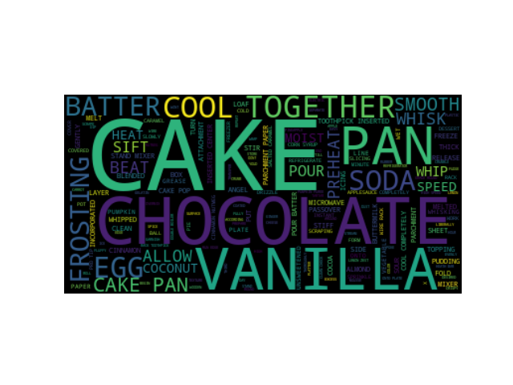
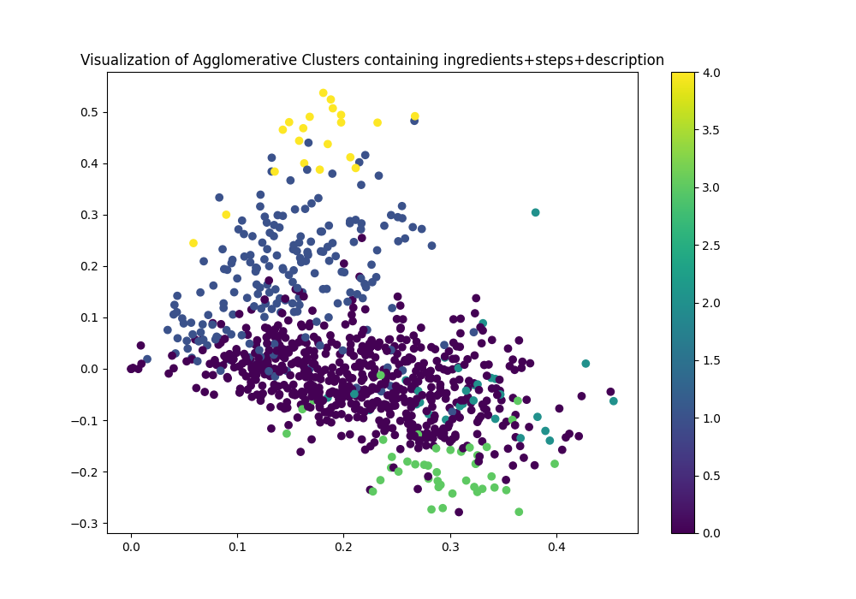
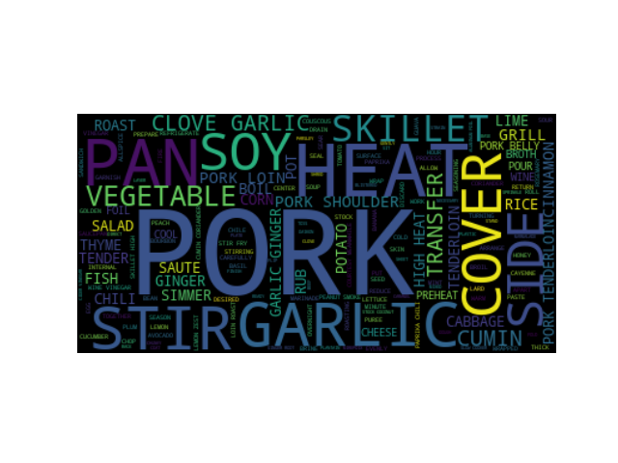
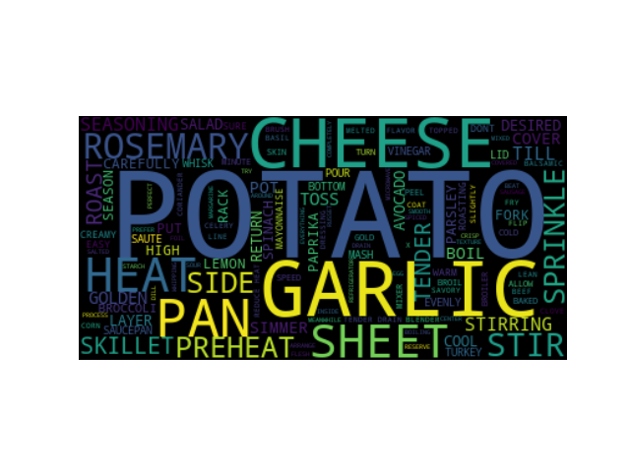
Cluster 0 (Purple)
Agglomerative
Cluster 1 (Blue)
The cluster for the best Agglomerative algorithm are very similar to the Kmeans cluster, suffering from the same downsides.
The wordcount is very similar to KMeans, the cluster labels are switched around, but comparing cluster 0 with cluster 2 from Kmeans, we see nearly identical wordcounts
One more cluster is being detected, focused on chocolate. This breaks down the Blue cluster form KMeans which had cake recipes in it.
Again, Heat and Garlic show up in various cluster as top words
Cluster 4 (Yellow)
Cluster 2 (Turqois)
Cluster 3 (Green)

Slide 20
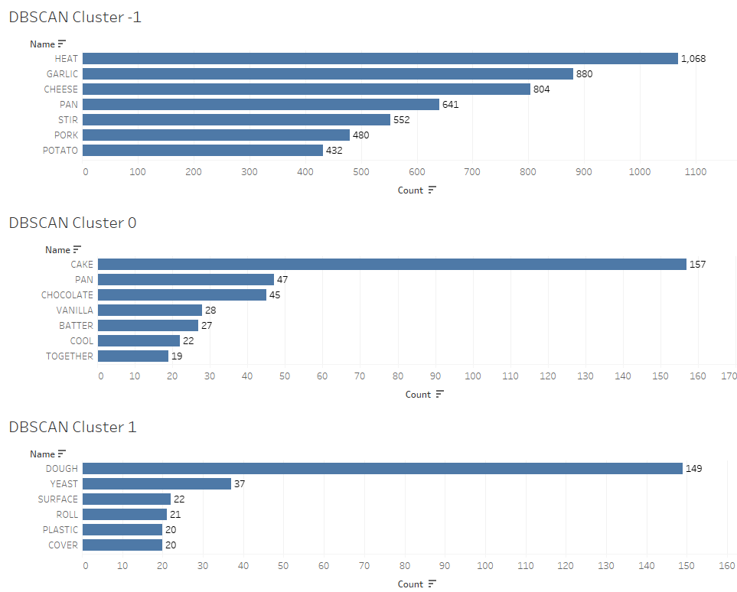
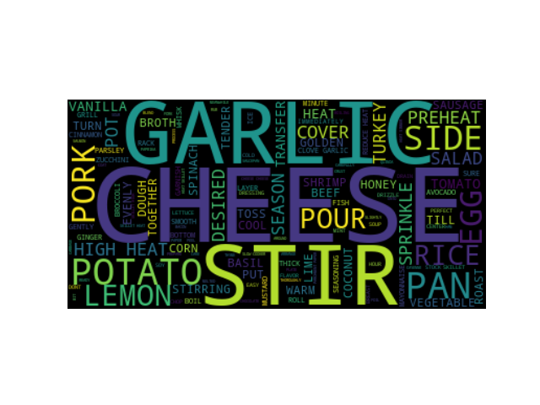
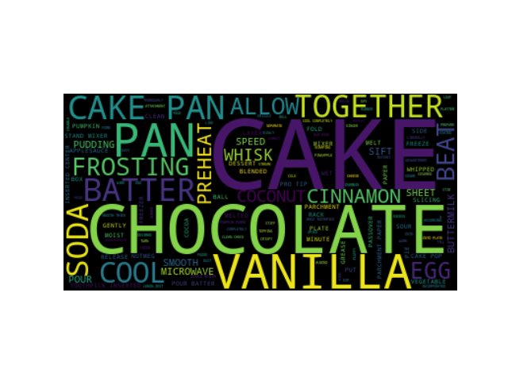
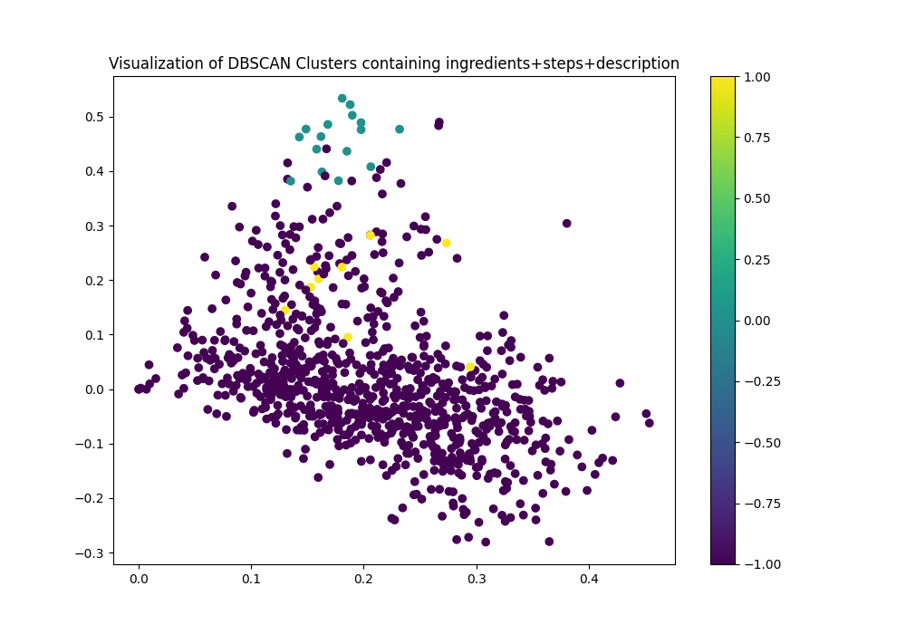
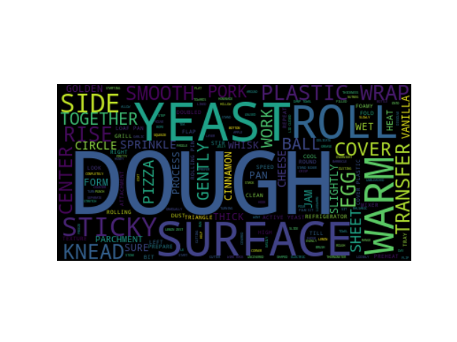
Cluster -1 (Purple)
DBSCAN
The DBSCAN algorithm had the hardest time identifying well defined clusters as can be seen on the cluster image (bottom left)
The wordclouds are separated into Heated Recipes with Cheese and Garlic and into two variations of baking recipes.
Cluster –1 (purple) with nearly all recipes packed into it since 'Heat' is found in most recipes, this cluster provides no useful information about the recipes. (could be hinted toward another stopword)
Cluster 0 (green) revolves around cakes and chocolate
Cluster 1 (yellow) has recipes with dough and yeast in it, probably more hearty variants of baking recipes.
Cluster 0 (Turqois)
Cluster 1 (Yellow)

Slide 21
Final Thoughts & Lessons Learned
The "best" algorithm for this clustering would be KMeans or Agglomerative, although the cluster only broadly categorize the recipes. A distinct separation is not possible with these results.
The recipes seemed to be very similar, even after removing a lot of stopwords and using different feature combinations, the cluster provide little to no information about separating recipes from another.
We faced difficulties in achieving optimal preprocessing and eliminating “unnecessary” words from the data.
The concept of “unnecessary” varies depending on the specific type of data we aimed to analyze. As an improvement, we could have used different preprocessing techniques for ingredients and steps.
The dataset was imbalanced, with a high frequency of measures, common ingredients and frequently used verbs.
A database/data management system for Tableau files would have been helpful. Collaboration on Tableau is challenging when the files are stored locally.
The arrangement and customization of Tableau is not practical - visualization through code is more flexible.
The structure and pipeline with MLFlow is much more organized for managing multiple models compared to Jupyter Notebooks.

